Slide 1
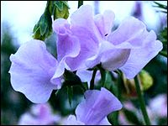
MENDEL & GENETICS
Campbell
Chapter 14

Slide 2
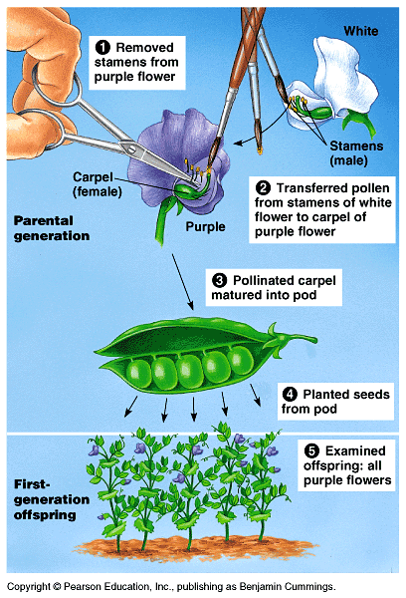
Mendel’s “Factors”
Austrian monk turned botanist
Heritable features-”characters” (genes)
Variations of characters-”traits” (alleles)
Traits are coded for by “genes”
Do all traits blend together?
Tested on pea plants
“Cross-pollination”
“Monohybrid cross”
Generations: P, F₁, F₂

Slide 3
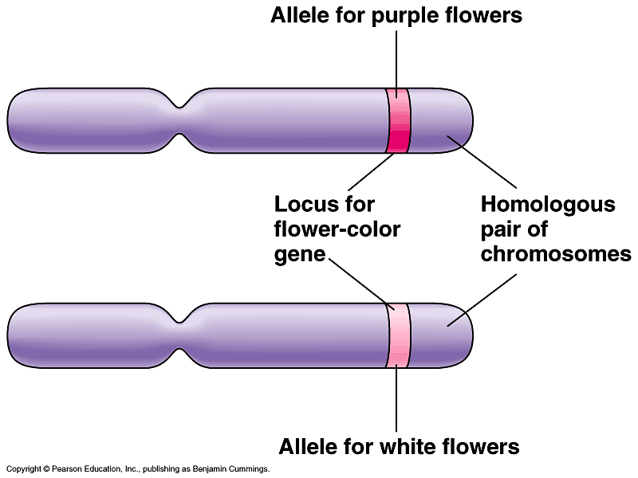

Slide 4
TERMS TO KNOW:
Dominant (P_) vs. Recessive (pp): Complete Dominance
Homozygous (PP or pp)
Heterozygous (Pp)
Phenotype (physical appearance of traits)
Genotype (actual alleles)
Testcross (unknown genotypes- used to determine alleles)
Dihybrid cross (looking at 2 traits)
Incomplete Dominance (F^{R}F^{W}-pink flower)
Codominance (F^{B}F^{Y}-blue w/ yellow blotches)

Slide 5
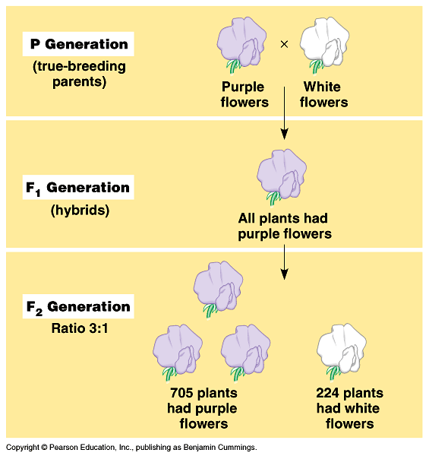
True-breeds:
2 copies of same allele (different version of a gene)
Hybrids:
Results when you cross 2 different true-breds

Slide 6
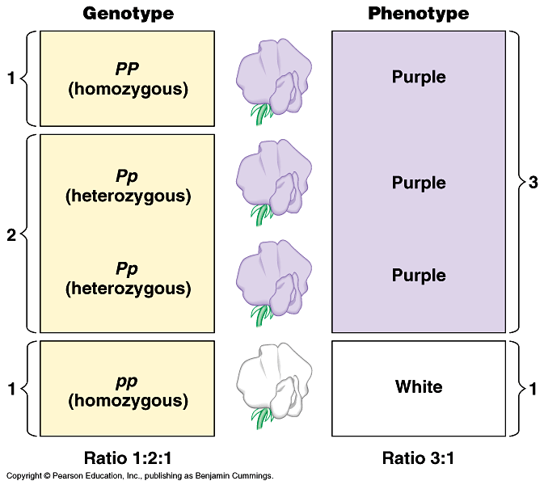

Slide 7
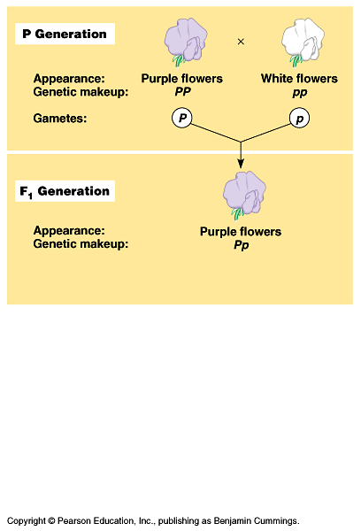

Slide 8
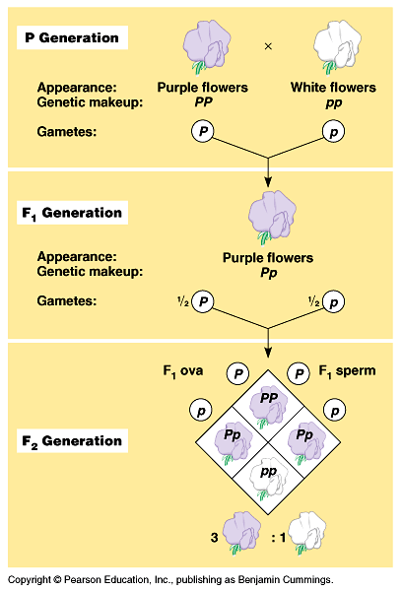

Slide 9
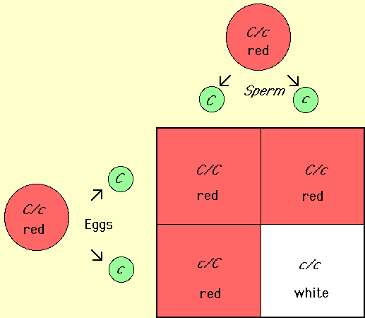
LAW OF SEGREGATION
2 alleles for a character are packaged into separate gametes
Meiosis & gametogenesis supports this law
Punnett square is used to predict offspring

Slide 10
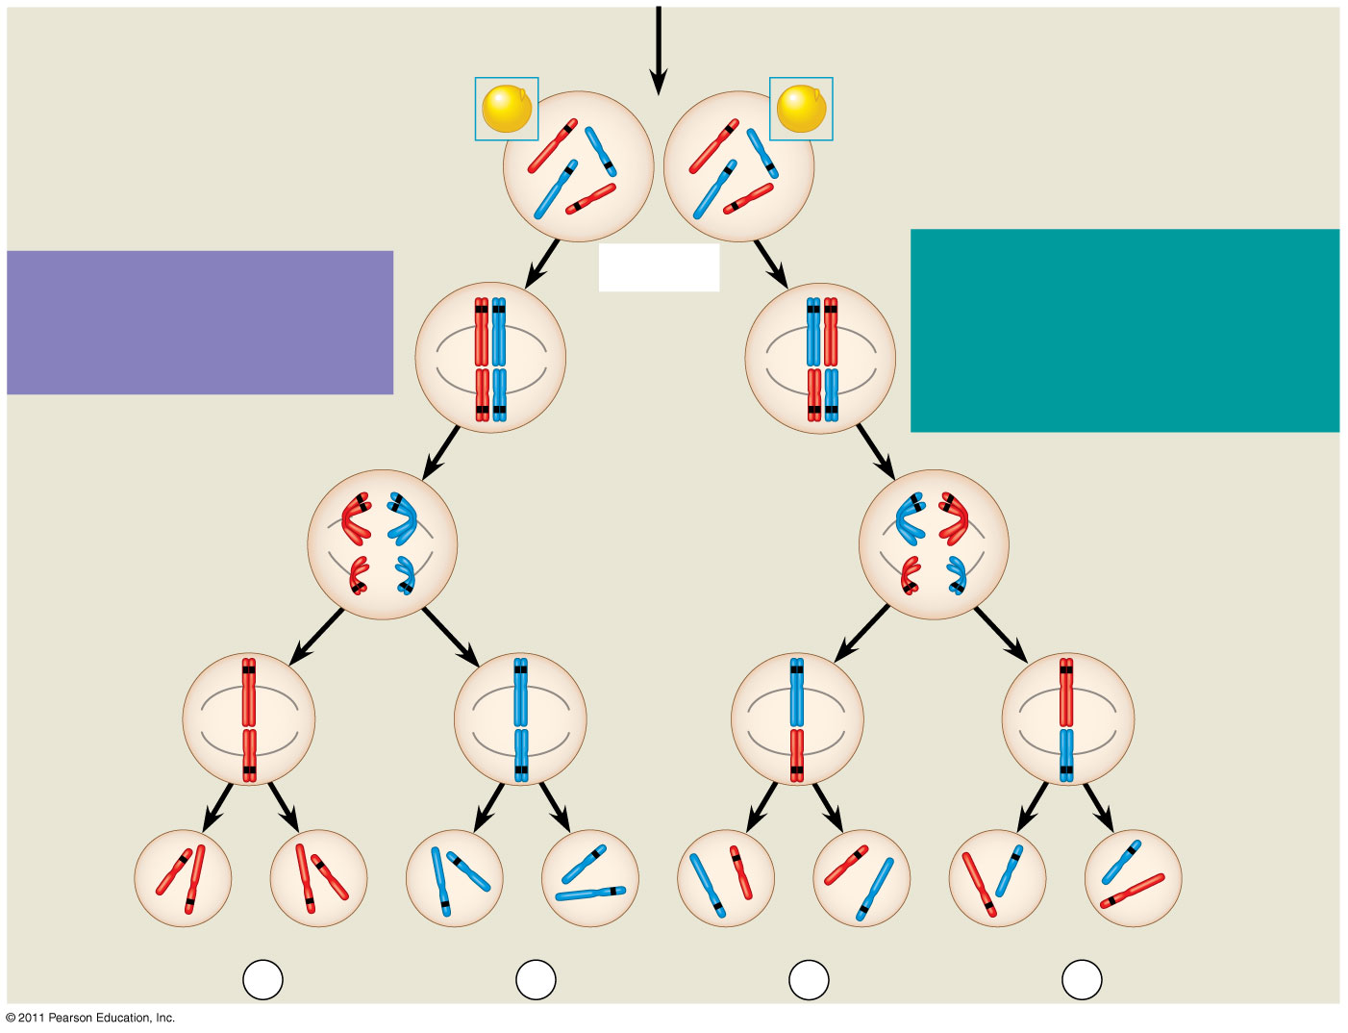
Figure 15.2b
All F₁ plants produce
yellow-round seeds (YyRr).
F₁ Generation
R
R
r
y
r
y
Y
Y
Meiosis
LAW OF INDEPENDENT
ASSORTMENT Alleles of
genes on nonhomologous
chromosomes assort
independently during gamete
formation.
LAW OF SEGREGATION
The two alleles for each
gene separate during
gamete formation.
R
r
r
R
Metaphase I
Y
y
Y
y
1
1
R
r
r
R
Anaphase I
Y
y
Y
y
R
r
Metaphase
II
r
R
2
2
Y
y
Y
y
Y
Y
y
y
Y
Y
y
y
Gametes
r
R
R
r
r
r
R
R
¹/₄
YR
¹/₄
yr
¹/₄
Yr
¹/₄
yR
Notes:
Figure 15.2 The chromosomal basis of Mendel’s laws.

Slide 11
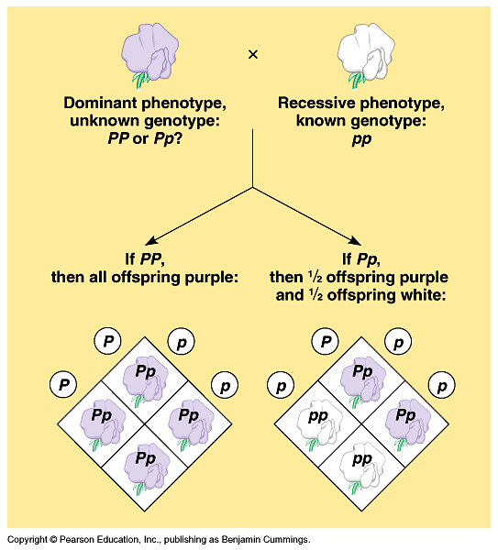

Slide 12
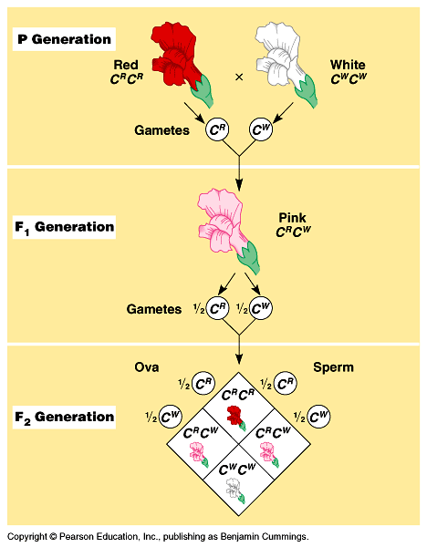
Incomplete dominance – hybrids have a phenotype that is a combination of parents

Slide 13
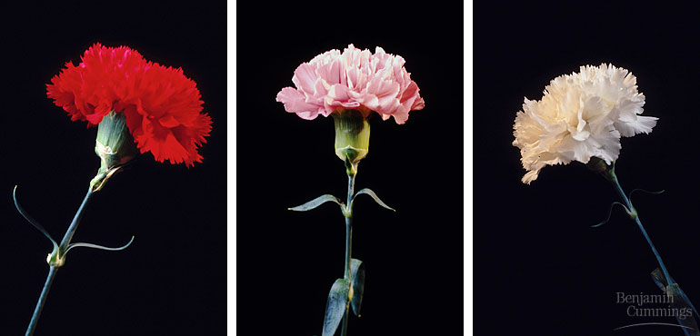

Slide 14
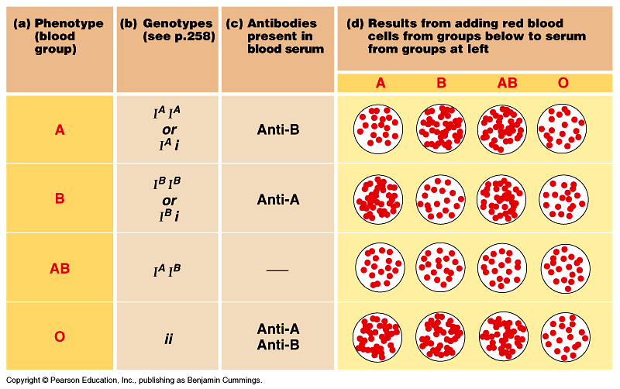
Codominance – two alleles both affect the phenotype in distinguishable ways – hybrids are not intermediates but rather a new phenotype expressing both alleles

Slide 15
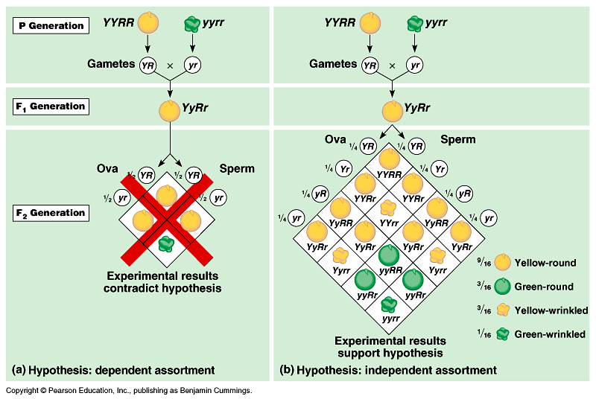
Dihibrid cross – also read p.259

Slide 16
Pleiotrophy
Inheritance:
When a gene has multiple phenotypic effects (cystic fibrosis and sickle-cell disease)

Slide 17
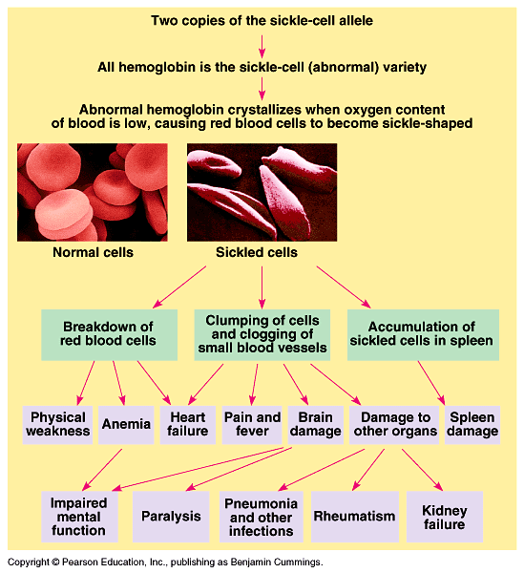
PLEIOTROPY:
One gene controls multiple phenotypes

Slide 18
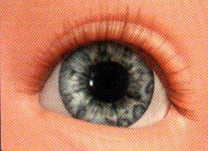
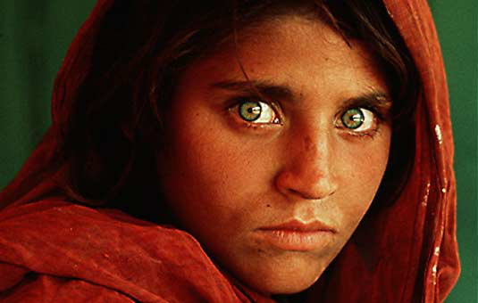
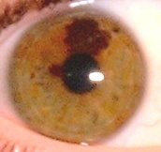
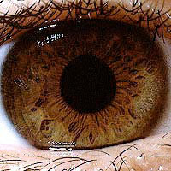
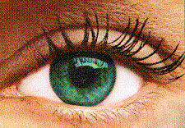
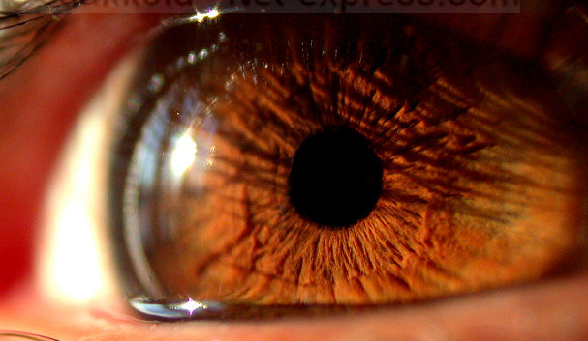
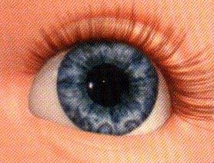
Human Iris-Color:
-controlled by at least 3 different genes

Slide 19
Polygenic
Inheritance:
Characters in a population
vary along a continuum – an additive effect of two or more genes to decide a phenotype

Slide 20
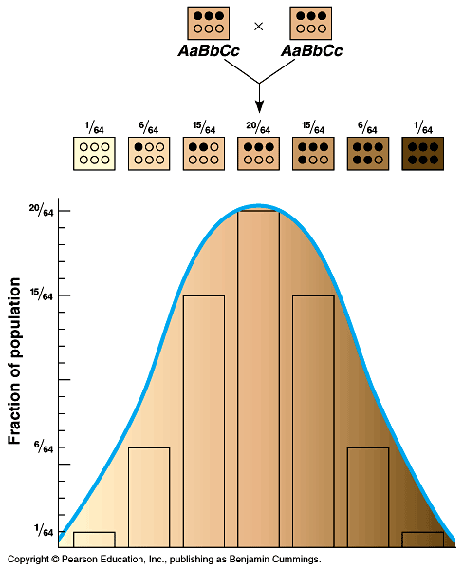
Continuous Variation:
Human height varies in
a population

Slide 21
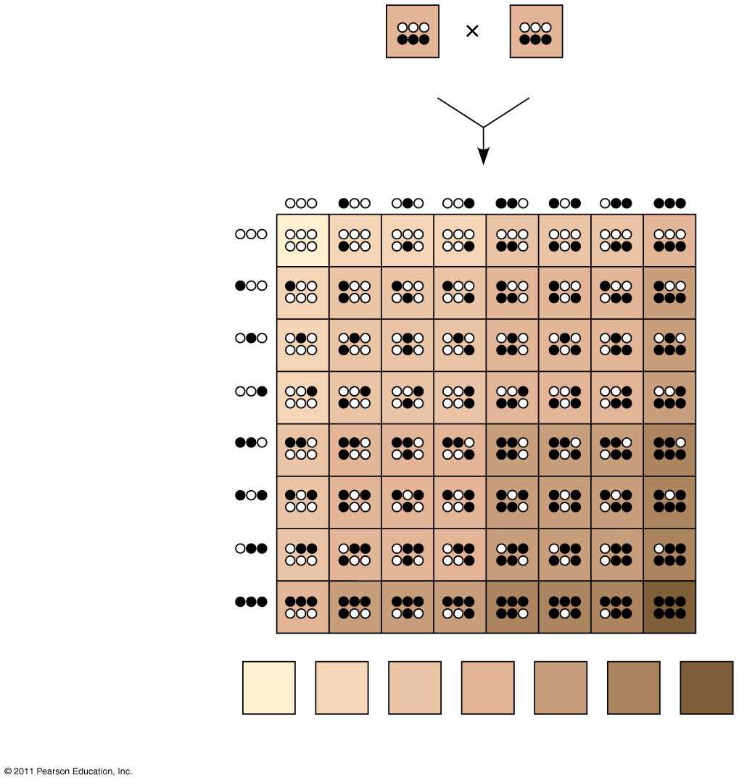
Figure 14.13
AaBbCc
AaBbCc
Sperm
¹/₈
¹/₈
¹/₈
¹/₈
¹/₈
¹/₈
¹/₈
¹/₈
¹/₈
¹/₈
¹/₈
¹/₈
Eggs
¹/₈
¹/₈
¹/₈
¹/₈
Phenotypes:
¹/₆₄
⁶/₆₄
¹⁵/₆₄
²⁰/₆₄
¹⁵/₆₄
⁶/₆₄
¹/₆₄
Number of
dark-skin alleles:
0
1
2
3
4
5
6
Notes:
Figure 14.13 A simplified model for polygenic inheritance of skin color.

Slide 22
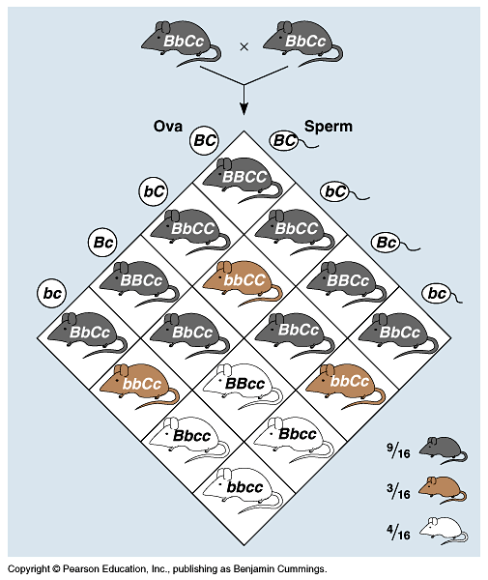
EPISTASIS:
Multiple genes controlling one phenotype

Slide 23
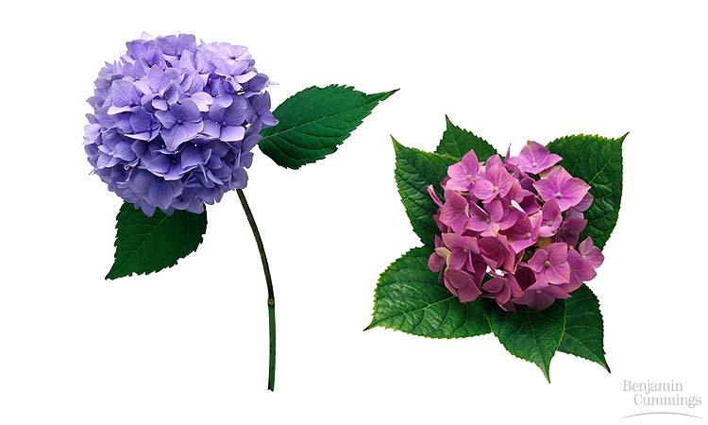
Nature vs. Nurture
Genes vs. Environment

Slide 24
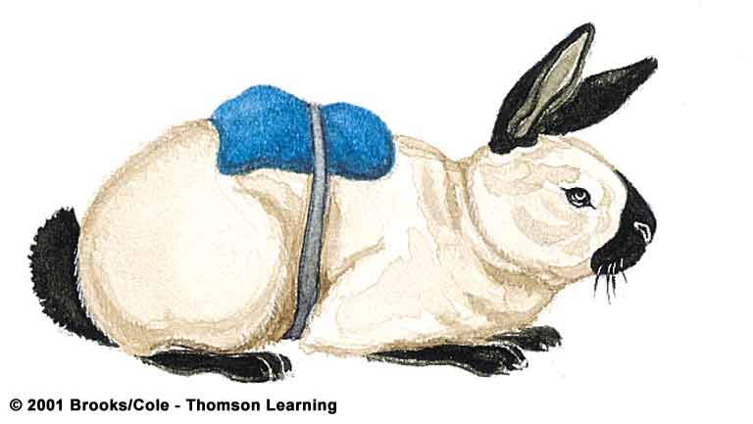
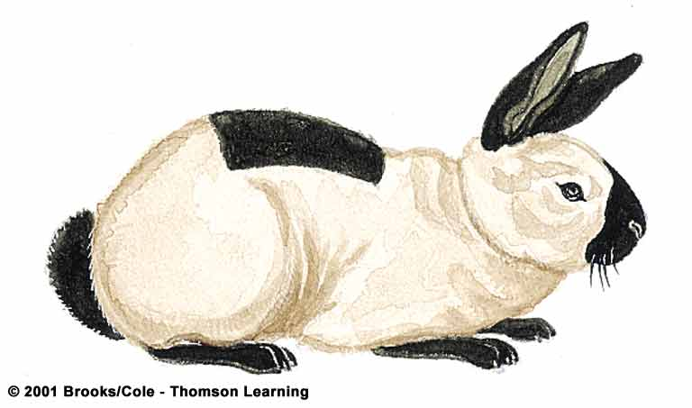
Temperature Effects on Phenotype
Himalayan rabbits are homozygous for an allele that specifies a heat-sensitive version of an enzyme in melanin-producing pathway
Melanin is produced in cooler areas of body

Slide 25
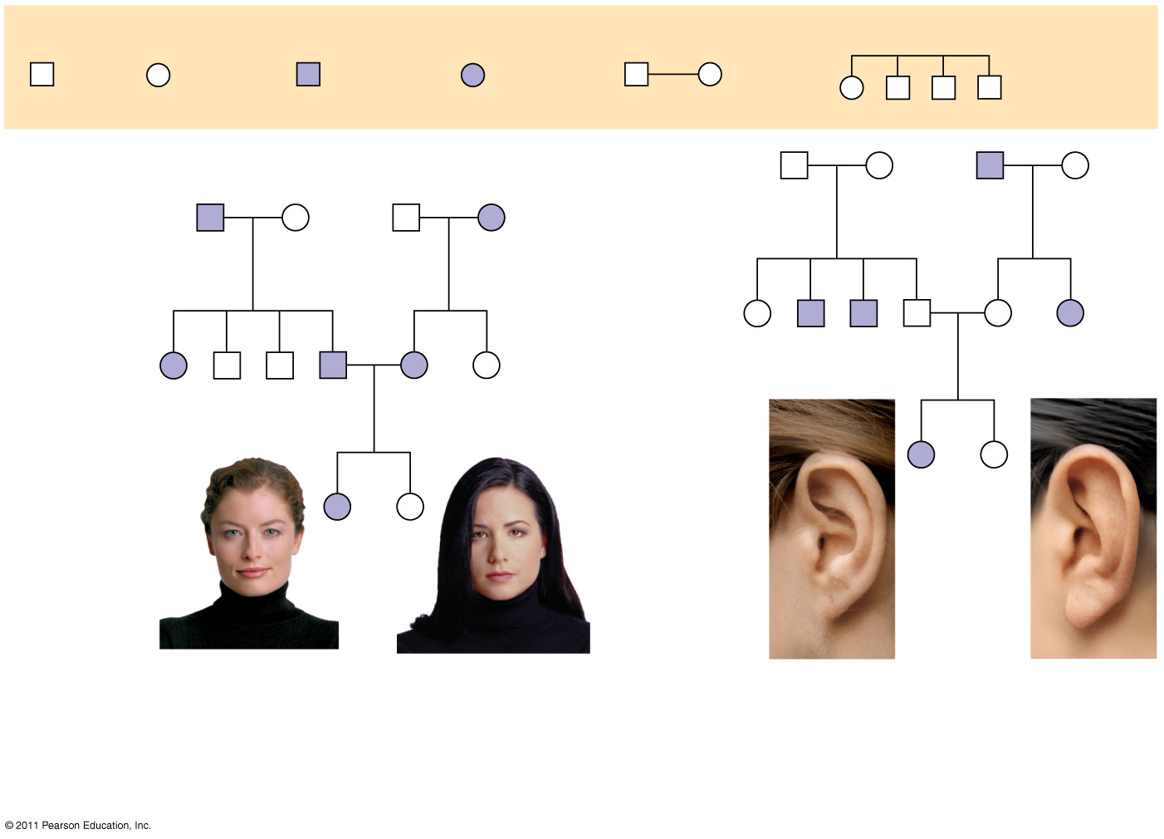
Figure 14.15
Key
Male
Female
Affected
male
Affected
female
Mating
Offspring
1st
generation
1st
generation
Ff
Ff
ff
Ff
Ww
ww
ww
Ww
2nd
generation
2nd
generation
FF or Ff
ff
ff
Ff
Ff
ff
Ww
ww
ww
Ww
Ww
ww
3rd
generation
3rd
generation
ff
FF
or
Ff
WW
or
Ww
ww
Widow’s
peak
No widow’s
peak
Attached
earlobe
Free
earlobe
(a)
Is a widow’s peak a dominant or
recessive trait?
b)
Is an attached earlobe a dominant
or recessive trait?
Notes:
Figure 14.15 Pedigree analysis.

Slide 26
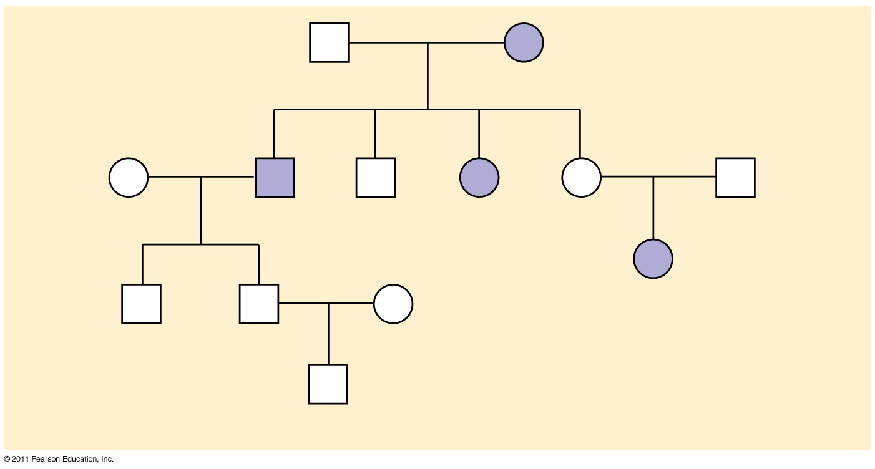
Figure 14.UN07
George
Arlene
Sandra
Tom
Sam
Wilma
Ann
Michael
Carla
Daniel
Alan
Tina
Christopher
Notes:
Figure 14.UN07 Test Your Understanding, question 18

Slide 27
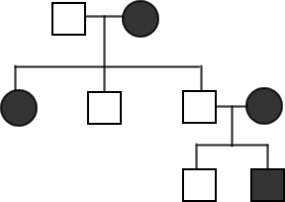
Practice . .. .
Determine the genotypes in the pedigree. The trait being studied is the tongue rolling ability. Those who cannot roll their tongue are recessive (tt)

Slide 28
The Behavior of Recessive Alleles
Recessively inherited disorders show up only in individuals homozygous for the allele
Carriers are heterozygous individuals who carry the recessive allele but are phenotypically normal; most individuals with recessive disorders are born to carrier parents
Albinism is a recessive condition characterized by a lack of pigmentation in skin and hair
© 2011 Pearson Education, Inc.
© 2011 Pearson Education, Inc.

Slide 29
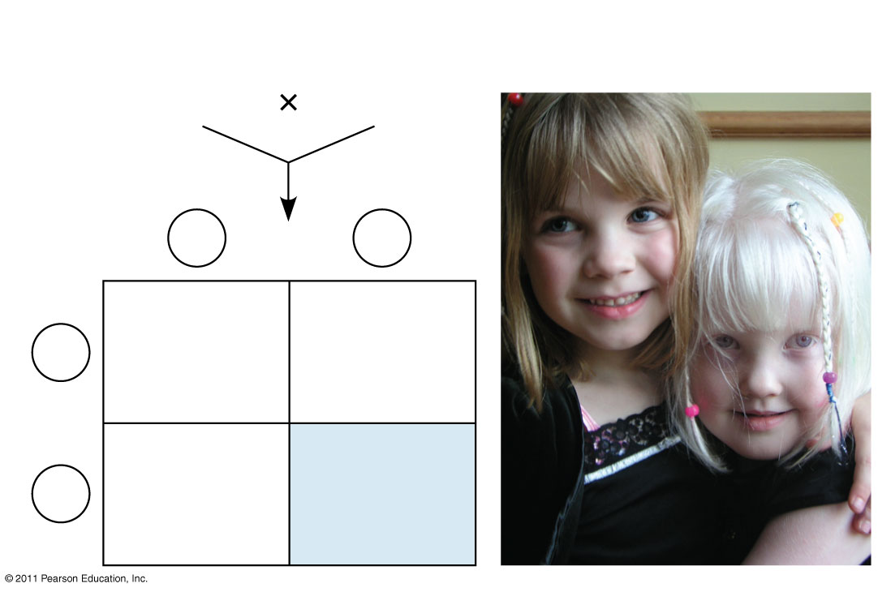
Figure 14.16
Parents
Normal
Aa
Normal
Aa
Sperm
A
a
Eggs
AA
Normal
Aa
Normal
(carrier)
A
Aa
Normal
(carrier)
a
aa
Albino
Notes:
Figure 14.16 Albinism: a recessive trait.

Slide 30
If a recessive allele that causes a disease is rare, then the chance of two carriers meeting and mating is low
Consanguineous matings (i.e., matings between close relatives) increase the chance of mating between two carriers of the same rare allele
Most societies and cultures have laws or taboos against marriages between close relatives
© 2011 Pearson Education, Inc.

Slide 31
Dominantly Inherited Disorders
Some human disorders are caused by dominant alleles
Dominant alleles that cause a lethal disease are rare and arise by mutation
Achondroplasia is a form of dwarfism caused by a rare dominant allele
© 2011 Pearson Education, Inc.

Slide 32
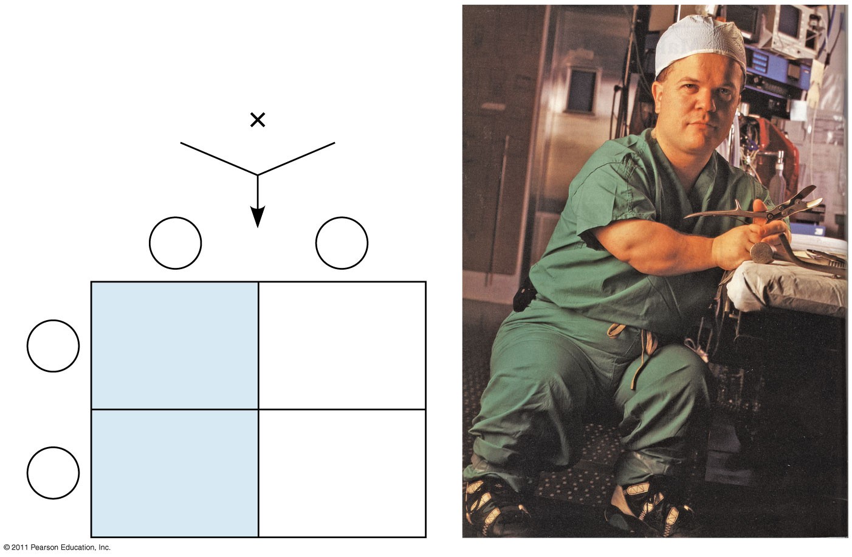
Figure 14.17
Parents
Dwarf
Dd
Normal
dd
Sperm
D
d
Eggs
Dd
Dwarf
dd
Normal
d
Dd
Dwarf
dd
Normal
d
Notes:
Figure 14.17 Achondroplasia: a dominant trait.

Slide 33
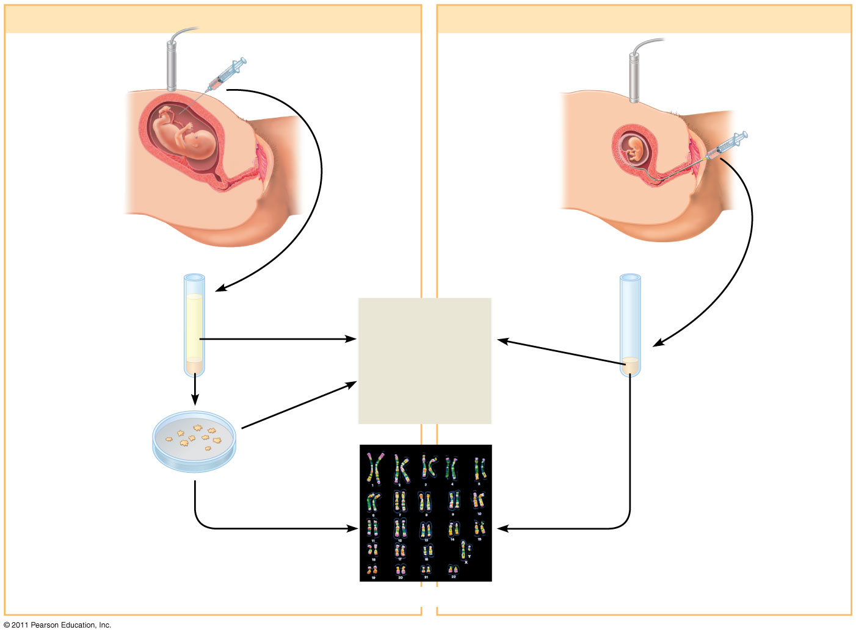
Figure 14.19
(a) Amniocentesis
(b) Chorionic villus sampling (CVS)
1
Ultrasound monitor
Amniotic
fluid
withdrawn
Ultrasound
monitor
Fetus
1
Fetus
Placenta
Suction
tube
inserted
through
cervix
Placenta
Chorionic villi
Uterus
Cervix
Cervix
Uterus
Centrifugation
Fluid
Several hours
Several
hours
2
Biochemical
and genetic
tests
Fetal
cells
Several
weeks
Fetal cells
2
Several weeks
Several hours
3
Karyotyping
Notes:
Figure 14.19 Testing a fetus for genetic disorders.

Slide 34
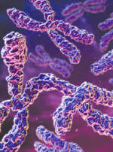
Chromosomal Basis of Inheritance
Chapter 15

Slide 35
Chromosomes theory of inheritance
Genes have specific loci on chromosomes
Mendelian genes-chromosomes undergo segregation & independent assortment
As it turns out, not all genes behave this way

Slide 36
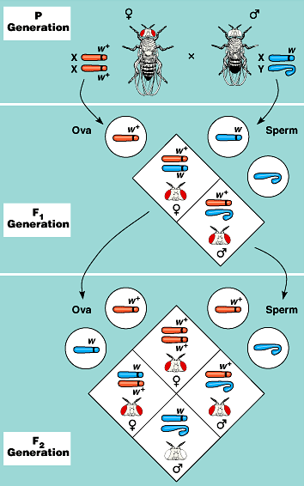
Thomas Hunt Morgan experimented w/ fruit flies
Found certain genes were linked to sex chromosomes
Genes located on either “X” or “Y” are called: sex-linked
Linked-genes are genes on the SAME chromosomes
Linked genes tend to be inherited together
How might they become unlinked?
Answer: Crossing-over

Slide 37
Variations in Inheritance
Linked genes
Sex-linked traits
Sex-linked disorders
  Duchenne muscular dystrophy (dystrophin)
  hemophilia
  Mosaic (inactive X or Barr body)
Genetic recombination

Slide 38
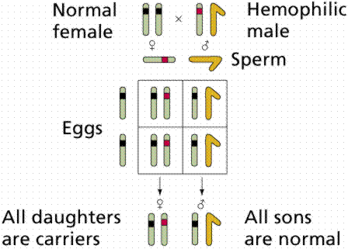
Sex-Linked Traits

Slide 39
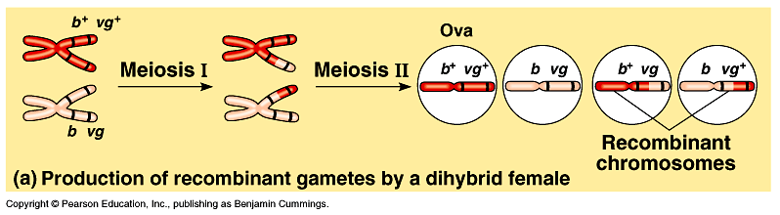
Figure 15.5a Recombination due to crossing over

Slide 40
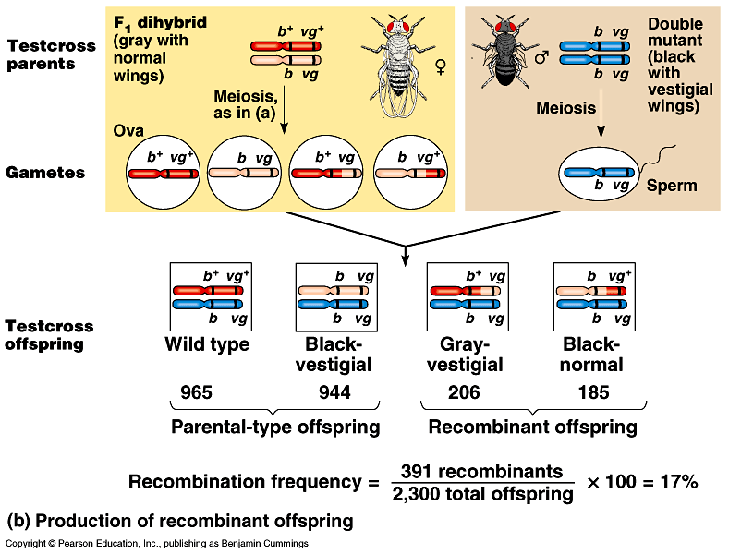
Figure 15.5b Recombination due to crossing over

Slide 41
A linkage map is a genetic map of a chromosome based on recombination frequencies
Distances between genes can be expressed as map units; one map unit, or centimorgan, represents a 1% recombination frequency
Map units indicate relative distance and order, not precise locations of genes
© 2011 Pearson Education, Inc.

Slide 42
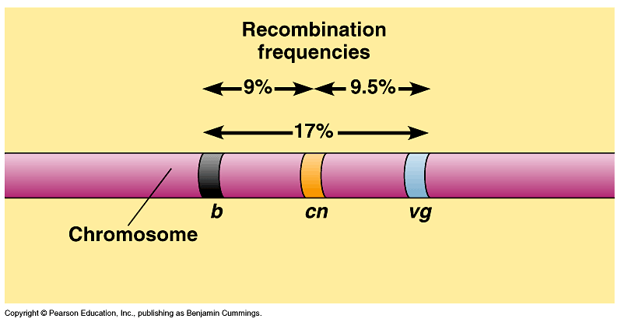
Figure 15.6 Using recombination frequencies to construct a genetic map

Slide 43
Genes that are far apart on the same chromosome can have a recombination frequency near 50%
Such genes are physically linked, but genetically unlinked, and behave as if found on different chromosomes
© 2011 Pearson Education, Inc.

Slide 44
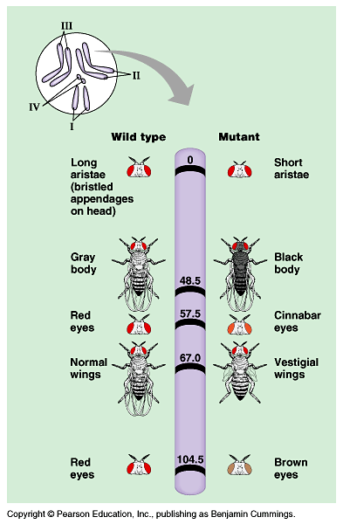
Figure 15.7 A partial genetic map of a Drosophila chromosome

Slide 45
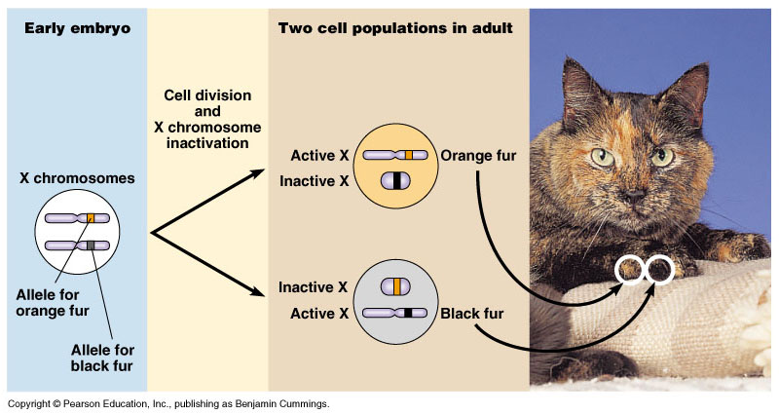

Slide 46
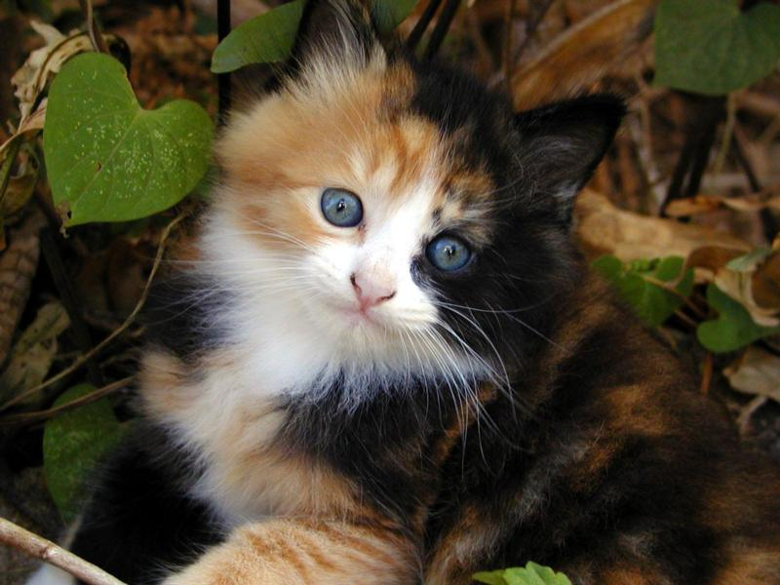

Slide 47
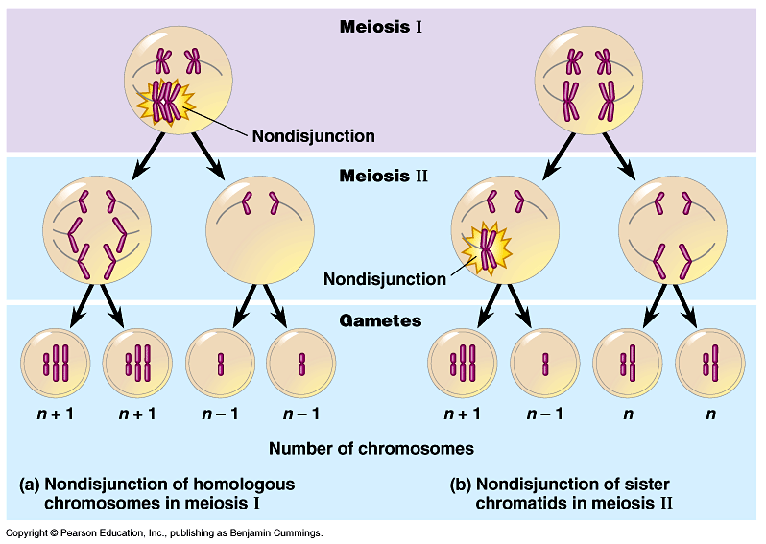

Slide 48
Alterations of Chromosome Structure
Breakage of a chromosome can lead to four types of changes in chromosome structure
  Deletion removes a chromosomal segment
  Duplication repeats a segment
  Inversion reverses orientation of a segment within a chromosome
  Translocation moves a segment from one chromosome to another
© 2011 Pearson Education, Inc.

Slide 49
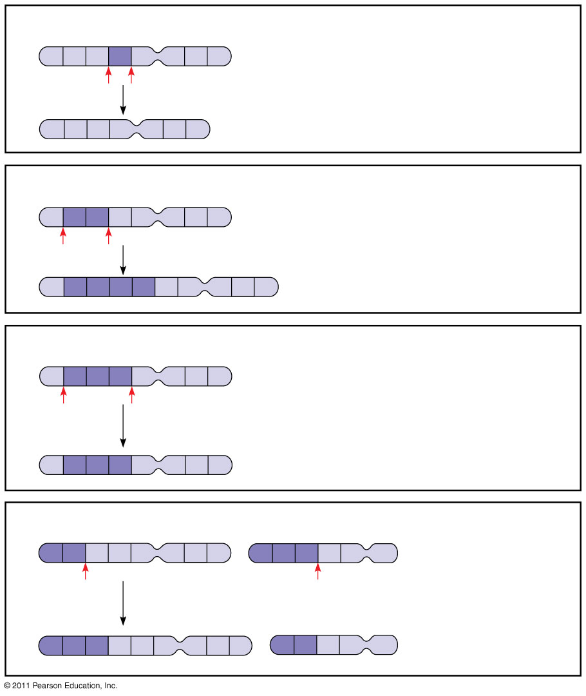
Figure 15.14
(a) Deletion
A
B
C
D
E
F
G
H
A deletion removes a chromosomal segment.
A
B
C
E
F
G
H
(b) Duplication
A
B
C
D
E
F
G
H
A duplication repeats a segment.
A
B
C
B
C
D
E
F
G
H
(c) Inversion
A
B
C
D
E
F
G
H
An inversion reverses a segment within a
chromosome.
A
D
C
B
E
F
G
H
(d) Translocation
A
B
C
D
E
F
G
H
M
N
O
P
Q
R
A translocation moves a segment from one
chromosome to a nonhomologous chromosome.
M
N
O
C
D
E
F
A
B
P
Q
R
G
H
Notes:
Figure 15.14 Alterations of chromosome structure.

Slide 50
Variation In Offspring?
Independent assortment of chromosomes
Crossing-over
Random union of the sperm & egg
Recombination of linked genes due to crossing-over (closer they are, the less likely they are to be separated)
GENETIC MAPS show the ordered list of genetic loci along a particular chromosome

Slide 51
